Slide 1
The Battle of Neighbourhoods
Brisbane Suburbs

Slide 2
Business Problem
I recently moved to Brisbane and I am new to this place.
In which suburb should I buy a house?
I like the suburb where I live but I want more choice.
What I like about my suburb is
1.A Good Shopping Mall
2.Public transport options.
3.Parklands

Slide 3
Data
Foursquare data: Venue name ,Venue category
Using Foursquare API requests
Brisbane Suburb names, Post code and geographic coordinates
Obtained from Wikipedia
The venue data is appended to Brisbane suburb data ,encoded normalised and then clustered.

Slide 4
Methodology
Requirement:
Foursquare location data to be used
Assumption:
Venues in an area depend on the people living in the area.
Hence similar suburb can be identified by comparing
venues in the suburbs.
Clustering:
Similar suburbs are found by doing K means clustering.
Distance Matrix
Distance matrix will be used to identify 9 most similar suburbs from the cluster of interest.

Slide 5
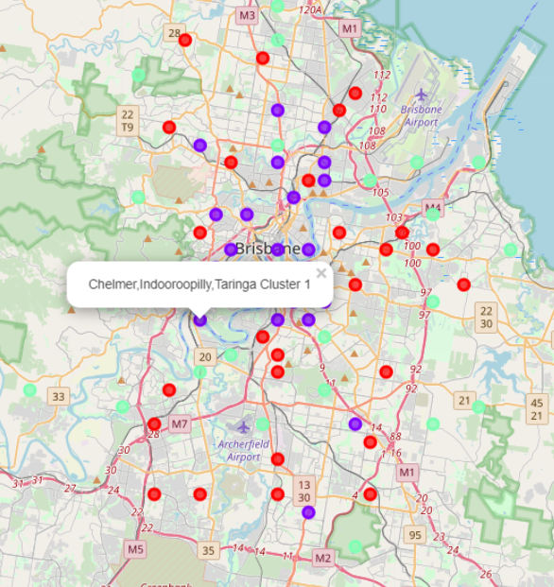
K Means clustering
Three clusters were formed . Suburb of interest is shown

Slide 6
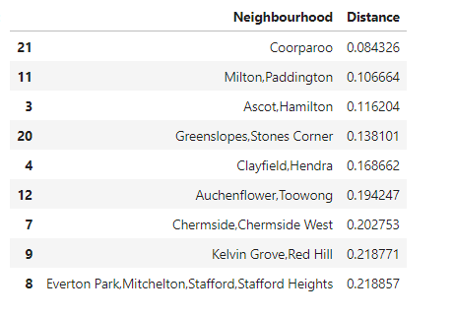
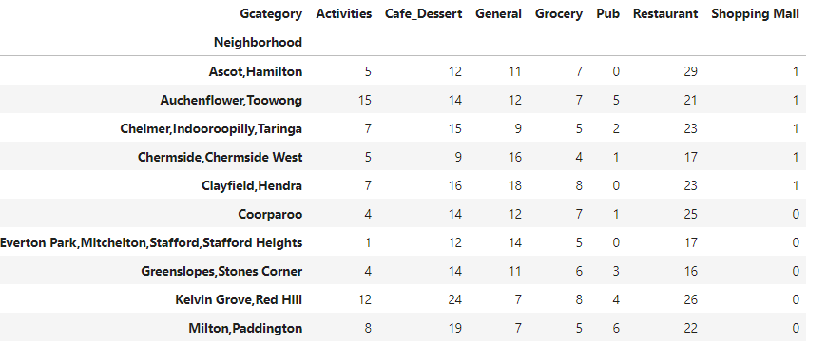
9 Suburbs similar toIndooroopillyand the number of venues present

Slide 7
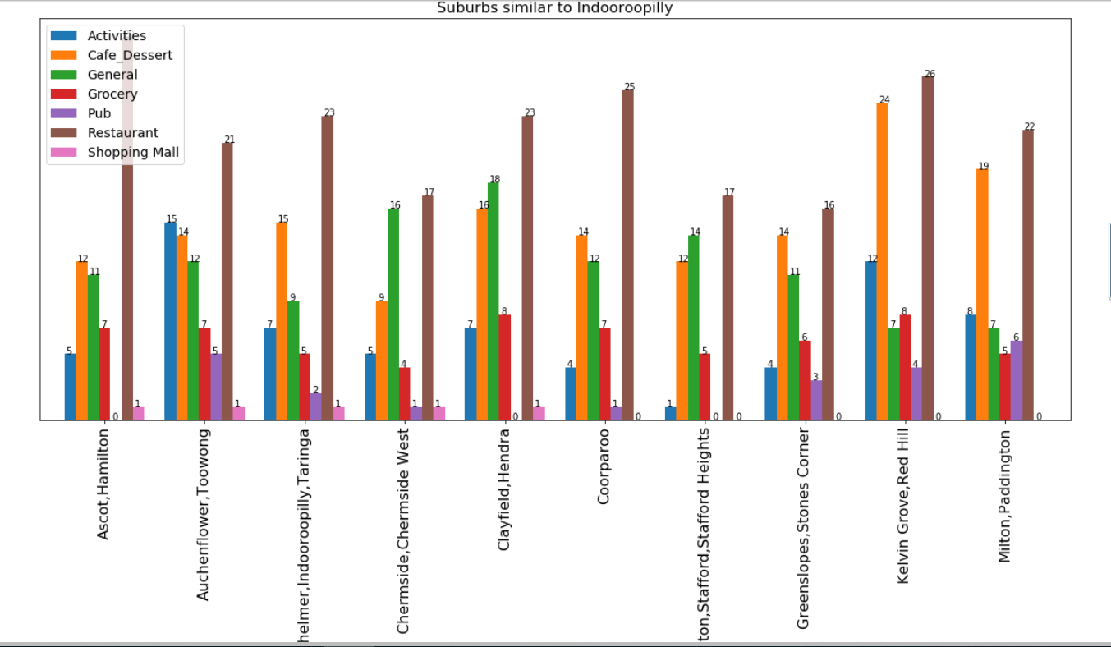
Visualisation

Slide 8
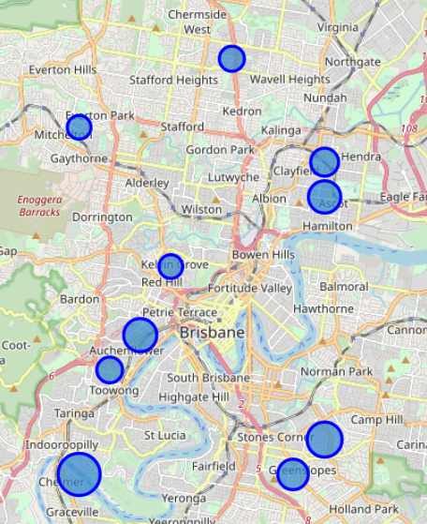
Similar suburbs-Size of Bubble represent magnitude of similarity

Slide 9
Discussion/Conclusion
Suburbs were clustered ,similar ones identified and ranked in the order of similarity.
Inclusion of transport venues would give more information about suburbs.
Results depend on whether Foursquare data has equal representation of all suburbs.

Slide 10
Thank you!

